Slide 1
Boolean Algebra & Logic Gates
Chapter 2B
Imran Siddiqi
imran.siddiqi@mcs.edu.pk
Computer Science Department
College of Telecommunication Engineering
National University of Sciences and Technology

Slide 2
Implementation of Boolean Functions
  Draw the logic diagram for the following function: F = (a.b)+(b.c)
a
b
F
c

Slide 3
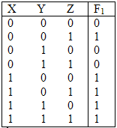
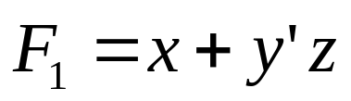
Implementation of Boolean Functions
Boolean Function expresses logical relationship between binary variables
Boolean Function can be represented by a Truth Table
x
F₁
y
z

Slide 4
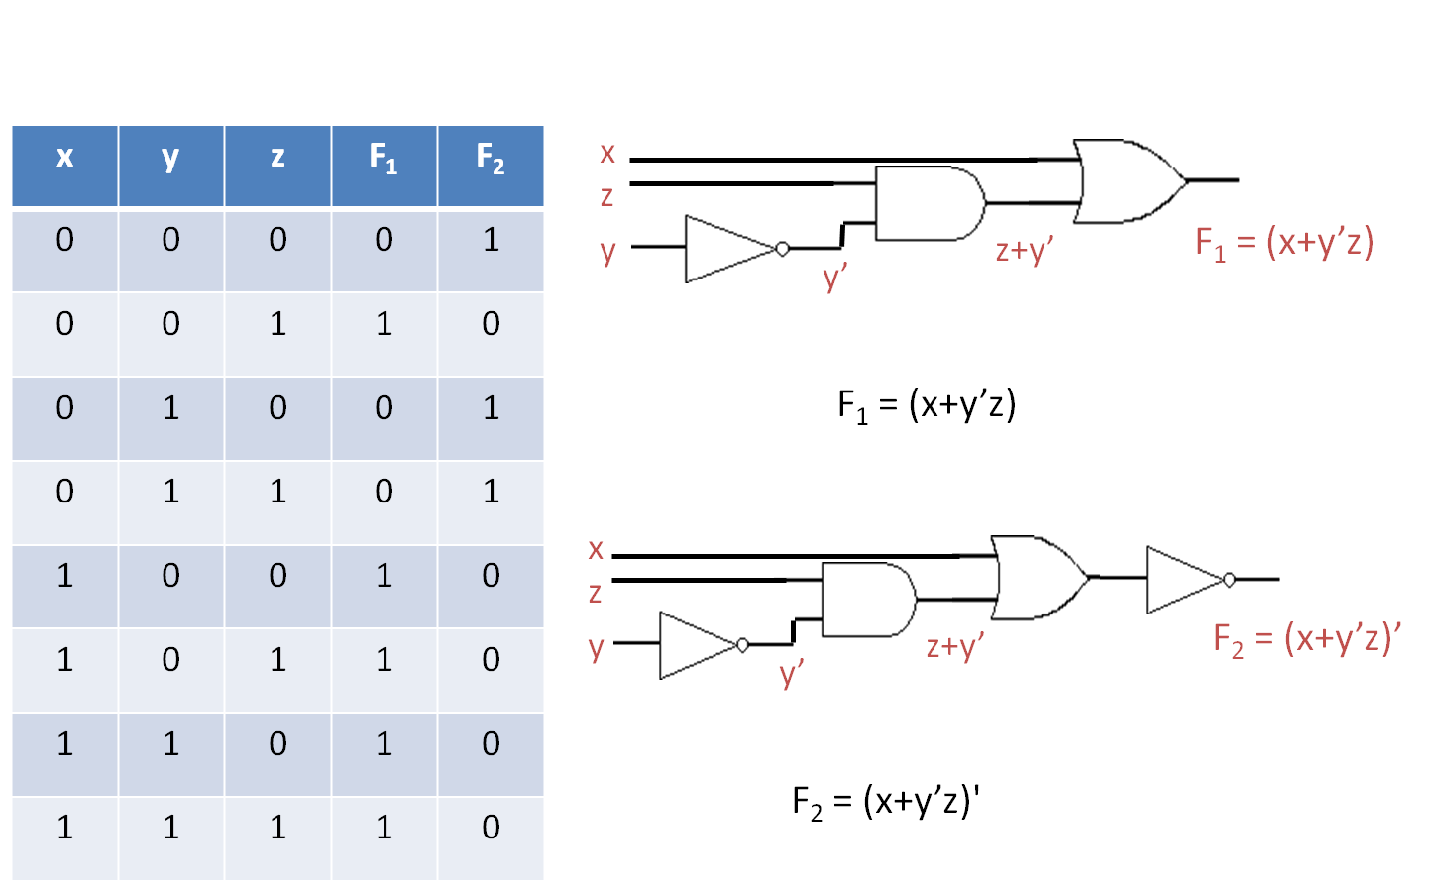
Implementation of Boolean Functions

Slide 5
Boolean Functions
Boolean functions, truth tables or logic diagrams can be generated from each other
Designers try to reduce complexity and number of gates to reduce circuit cost
Two different boolean functions may represent the same logic and truth table
A single variable in a boolean function is called literal
Group of literals which forming an input to a gate are together called a term

Slide 6
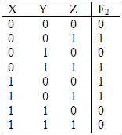

Implementation of Boolean Functions
Example 2:
x
y
F₂
z

Slide 7
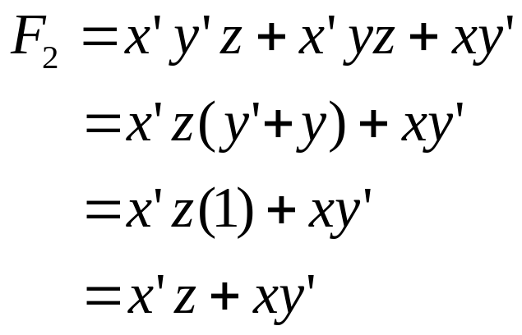
Implementation of Boolean Functions
Try another implementation using a simplified F₂:
Distributive Pos
Complement Pos
x
y
F₂
z
This implementation has fewer gates and fewer inputs to the gates (or wires) than the previous one.

Slide 8
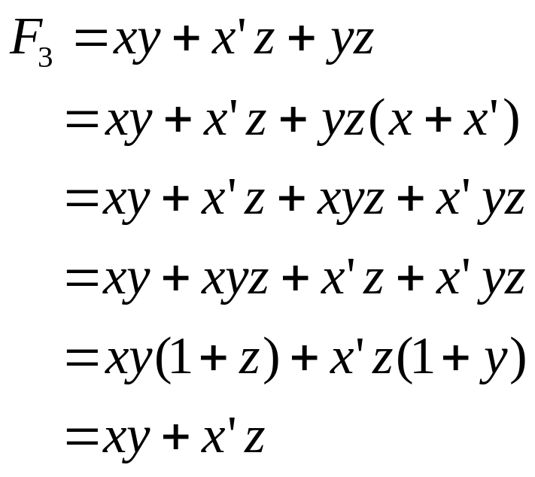
Simplifying Boolean Functions
Identity .1 is same & Complement Pos (x.x’)=1
Distributed Pos
Rearrange order
Distributed Pos
Theorem 2 (X+1 =1)
x
y
F₃
z

Slide 9
Complement of a Function
DeMorgan’s Theorem
(x+y)’ = x.’y’
(x.y)’=x’+y’
(A+B+C+D+…+F)’= A’B’C’D’…. F’
(ABCD…F)’ = A’+B’+C’+D’+… + F’
The complement of a function can be obtained by interchanging AND and OR operators and complementing each literal

Slide 10
Complement of a Function
Example: Find the complement of:
  F = x’yz’+x’y’z
F’ = (x’yz’+x’y’z)’
= (x’yz’)’.(x’y’z)’
=(x+y’+z).(x+y+z’)

Slide 11
Complement of a Function
Example: Find the complement of F by taking its dual and complementing each literal
  F = x’yz’+x’y’z
Dual of F
= (x’+y+z’).(x’+y’+z)
Complement each literal
=(x+y’+z).(x+y+z’) = F’

Slide 12
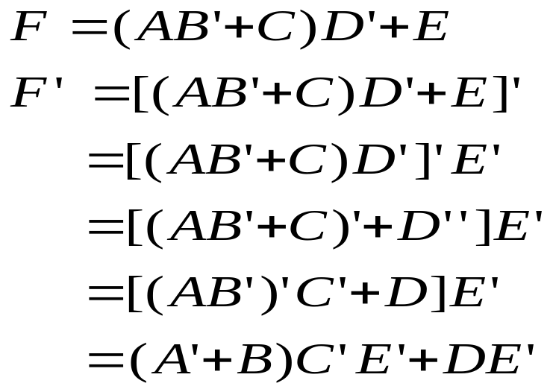
Complement of a Function
Example: Find the Complement of

Slide 13
Definitions
Product terms – AND → ĀBZ
Sum terms – OR → X + Ā

Slide 14
Minterms and Maxterms
n binary variables can be combined to form 2^{n} terms (AND terms), called Minterms or standard products.
In a similar fashion, n binary variables can be combined to form 2^{n} terms (OR terms), called Maxterms or standard sums.
Boolean Functions expressed in Sum of MinTerms or Product of MaxTerms are said to be in Canonical Form

Slide 15
Minterms and Maxterms
Each Minterm is obtained from an AND term. Variable primed if corresponding bit 0, vice versa
Each Maxterm is obtained from an OR term. Variable primed if corresponding bit 1, vice versa
x | y | z | minterm | maxterm
0 | 0 | 0 | x’.y’.z’ | x+y+z
0 | 0 | 1 | x’.y’.z | x+y+z’
0 | 1 | 0 | x’.y.z’ | x+y’+z
0 | 1 | 1 | x’.y.z | x+y’+z’
1 | 0 | 0 | x.y’.z’ | x’+y+z
1 | 0 | 1 | x.y’.z | x’+y+z’
1 | 1 | 0 | x.y.z’ | x’+y’+z
1 | 1 | 1 | x.y.z | x’+y’+z’

Slide 16
Minterms and Maxterms
x | y | z | minterm | designation | maxterm | designation
0 | 0 | 0 | x’.y’.z’ | m₀ | x+y+z | M₀
0 | 0 | 1 | x’.y’.z | m₁ | x+y+z’ | M₁
0 | 1 | 0 | x’.y.z’ | m₂ | x+y’+z | M₂
0 | 1 | 1 | x’.y.z | m₃ | x+y’+z’ | M₃
1 | 0 | 0 | x.y’.z’ | m₄ | x’+y+z | M₄
1 | 0 | 1 | x.y’.z | m₅ | x’+y+z’ | M₅
1 | 1 | 0 | x.y.z’ | m₆ | x’+y’+z | M₆
1 | 1 | 1 | x.y.z | m₇ | x’+y’+z’ | M₇

Slide 17
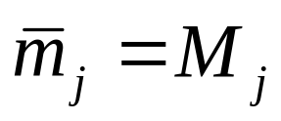
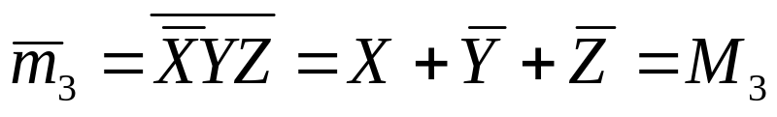
Minterms and Maxterms
Each minterm can also be called a Standard Product
Each maxterm can also be called a Standard Sum
For n variables there are 2^{n} minterms and maxterms
Each maxterm is the complement of corresponding minterm and vice versa

Slide 18
Representation of Functions
x | y | z | F1 | F2
0 | 0 | 0 | 0 | 0
0 | 0 | 1 | 1 | 0
0 | 1 | 0 | 0 | 0
0 | 1 | 1 | 0 | 1
1 | 0 | 0 | 1 | 0
1 | 0 | 1 | 0 | 1
1 | 1 | 0 | 0 | 1
1 | 1 | 1 | 1 | 1
Representation of Function in minterms
F1 = x’y’z+x’yz+xyz = m1 + m4 + m7
F2 = x’yz+xy’z+xyz’+xyz = m3 + m5 + m6 + m7
Representation of Function in maxterms
F1 = (x+y+z).(x+y’+z).(x+y’+z’).(x’+y+z’).(x’+y’+z)
= M0 . M2 . M3 . M5 . M6
F2 = (x+y+z).(x+y+z’).(x+y’+z).(x’+y+z)
= M0 . M1 . M2 . M4
Boolean expression represented as sum of minterms or product of maxterms are said to be in Canonical Form

Slide 19
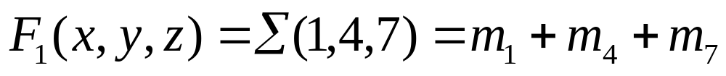
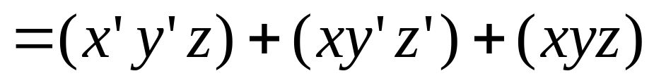
Sum of Minterms
Given the truth table, express F1 in sum of minterms
x y z F₁ F₂
0 0 0 0 1
0 0 1 1 0
0 1 0 0 1
0 1 1 0 1
1 0 0 1 0
1 0 1 0 0
1 1 0 0 0
1 1 1 1 0

Slide 20
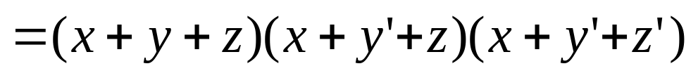
Product of Maxterms
Given the truth table, express F1 in Product of Maxterms
x y z F₁ F₂
0 0 0 0 1
0 0 1 1 0
0 1 0 0 1
0 1 1 0 1
1 0 0 1 0
1 0 1 1 0
1 1 0 1 0
1 1 1 1 0

Slide 21
References
Chapter 2 – Digital Design Morris Mano
Digital Logic Circuits – V.D. Agrawal, Auburn University, Auburn
Material in these slides has been taken from, the following resources

